Slide 1
MongoDB: Basics, Methods and Operators

Slide 2
What is a NoSQL database?
The NoSQL databases, sometimes also called non-SQL, non-relational, or not only SQL databases are those that have a different mechanism to store and retrieve data other than the tabular relations which are used in relational databases.
These types of databases have existed long ago but the term NoSQL is new, coined because of the requirements of today's companies that work on big, real-time data, and AI applications

Slide 3
MongoDB uses JSON-like data structures that are different from what we use in RDBMS, so it is also called a NoSQL database
Types of NoSQL database management systems
Key-value paired databases
Column-oriented databases
Document-oriented databases
Graph databases

Slide 4
Key-value paired databases These are the simplest NoSQL databases. Here, the data is stored as a name (or key) with its value. Some key-value paired databases also have the feature to give the data type such as int or float. Examples of key-value paired databases are: Berkeley DB Redis
Column-oriented databases These types of NoSQL databases allow you to store the columns of data instead of rows. These are very effective in handling the queries of large data sets. Examples of column-oriented databases are: Cassandra HBase
Document databases These databases pair each key with a data structure called to document and these documents then contain key-value pairs, key-array pairs, and nested documents. Examples of document databases are: MongoDB Couchbase
Graph databases These databases are useful in storing data that are inter-connected as nodes just like a graph. These databases add an extra layer of highlighting the relationship among the documents. Examples of document databases are: OrientDB Neo4j

Slide 5
MongoDB
MongoDB Database: A single MongoDB server consists of various databases where each database is a physical container of collections.
MongoDB Collection: A collection in MongoDB is equivalent to a database table of the SQL-based databases and it exists within a single database. It includes a group of MongoDB documents.
MongoDB Document: A document can be defined as an instance of a MongoDB collection. It includes a set of key-value pairs. All the documents include a dynamic schema which means the documents that comprise of the same collection do not need to have the same set of fields and structure.

Slide 6
Use this link to download the mongodb community edition and install like a service, download .msi file for installation
Try MongoDB Community Edition | MongoDB
Also download and install, use .msi file
Welcome to MongoDB Shell (mongosh) - MongoDB Shell
Also download and install .exe file
MongoDB Compass Download (GUI) | MongoDB

Slide 7
A collection in MongoDB is a grouping of MongoDB documents that hold data, usually dynamic in nature, because collection does not enforce a schema. A collection is equivalent to a table in RDBMS.
The important aspect of collection is that it allows dynamic schema, which means that a collection can hold documents that could be different in terms of their structure.
In RDBMS, we know that schema (or structure) is enforced by the table and thus, the data in the rows should be consistent in terms of the number of columns and column type as defined in a table while creating an it.
In MongoDB, collection can hold multiple documents which can have different documents with different data in terms of key-value or field-value pairs and data types

Slide 8
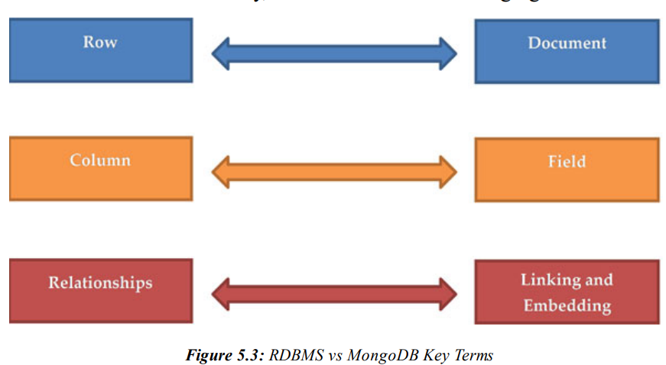
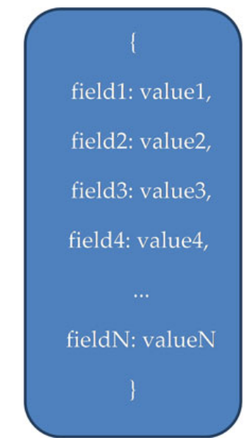

Slide 9
{
"_id": ObjectId("1"), // Document 1: No fixed schema
"booking_id": "B1001",
"customer_name": "Alice Johnson",
"contact_info": {
"email": "alice@example.com",
"phone": "123-456-7890"
},
"bus_route": "New York to Boston",
"booking_date": "2024-11-04",
"seat_number": "12A"
}
{
"_id": ObjectId("2"), // Document 2
"booking_id": "B1002",
"customer_name": "Bob Smith",
"contact_info": {
"email": "bob@example.com"
},
"bus_route": "San Francisco to Los Angeles",
"booking_date": "2024-11-04",
"seat_number": "15B",
"additional_requests": ["Window seat", "Extra legroom"]
}

Slide 10
MongoDB Shell is a JavaScript based interface which allows you to run various CRUD (Create, Read, Update, and Delete) and administrative operations.
db.help, Show dbs, use db, show collections
MongoDB Inc Compass : GUI

Slide 11
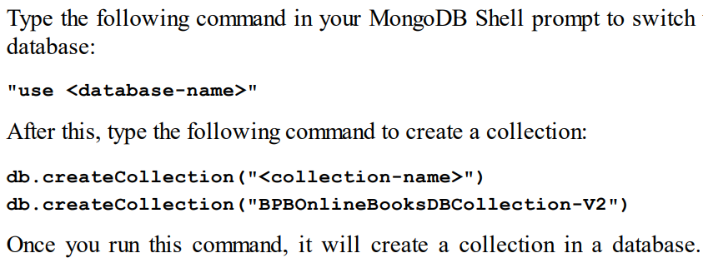

Slide 12
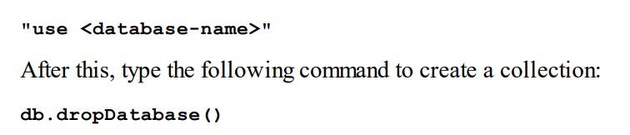
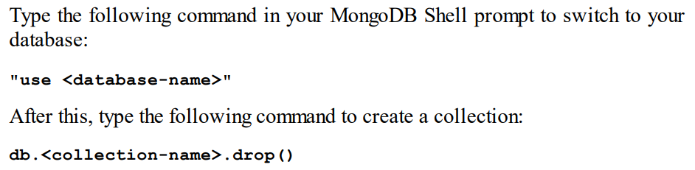

Slide 13
Add new db
test> use Bookstore
Create a new collection in your DB
Bookstore> db.createCollection(“Books")
Add a single document to your collection Books in compass
{ "title": my first book, `
"author": arun,
"pages": 345,
"genres":["comedy","tragedy"],
"rating":9
}

Slide 14
[
{
"title": "My First Story",
"author": "Arun",
"pages": 320,
"genres": ["comedy"],
"rating": 9
},
{
"title": "A Laugh and a Tear",
"author": "Arun",
"pages": 355,
"genres": ["comedy", "drama"],
"rating": 8
},
{
"title": "Tragicomic Tales",
"author": "Arun",
"pages": 340,
"genres": ["tragedy", "comedy"],
"rating": 9.5
}
]
Add a multiple document to your collection Books in compass

Slide 15

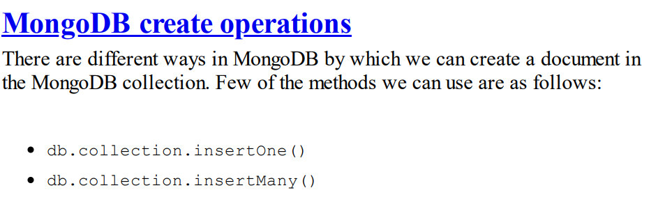

Slide 16
Insert new document to your collection
bookstore> use Bookstore
switched to db Bookstore
Bookstore> db.books.insertOne({title:"The man of glory",author: "Raj", pages: 456, rating:6})
Insert multiple documents to your collection
Bookstore> db.Books.insertMany([{ "title": "The Comic Melody","author": "Arun","pages": 340,"genres": ["comedy"],"rating": 8.5},{"title": "Drama in the Clouds","author": "Arun","pages": 365,"genres": ["drama"],"rating": 7.9},{"title": "Life in Laughter","author": "Arun", "pages": 360, "genres": ["comedy", "drama"], "rating": 8 }])

Slide 17
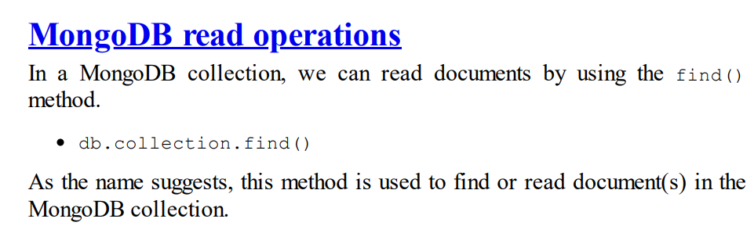
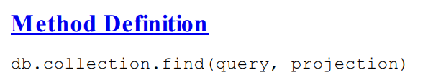
Bookstore> db.Books.find() // list documents available in the collection.

Slide 18
Bookstore> db.Books.find() // list documents available in the collection.
Bookstore> db.Books.find({rating:9}) // get the documents with rating 9
Bookstore> db.Books.find({author: "Arun", rating:9}) // get the documents with rating 9 and author name Arun
Bookstore> db.Books.find({rating: 9},{title:1,author:1}) // only if I want title and author details of rating 9 books
Bookstore> db.Books.find({},{title:1}) // find all titles of books within the collection

Slide 19
Bookstore> db.Books.findOne({_id:ObjectId("6711f406dc25875a0286b024")}) // find one document with specific id
Bookstore> db.Books.find({rating:9}).count() // no of books with rating 9
Bookstore> db.Books.find().limit(3) // get information of 3 books
Bookstore> db.Books.find().sort({rating:1}) // sort the books information by rating ascending order
Bookstore> db.Books.find().sort({rating:-1}) // sort the books information by rating descending order
Bookstore> db.Books.find().sort({rating:1}).limit(2)

Slide 20
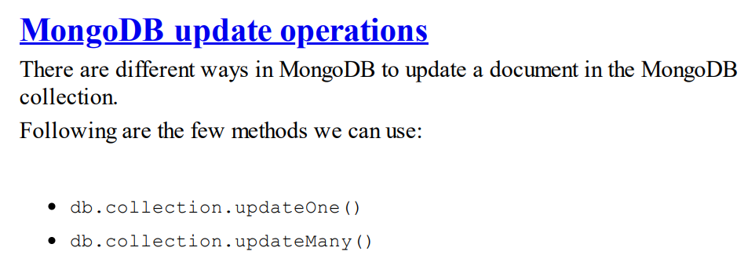
Bookstore> db.Books.updateOne({title:'Drama in the Clouds'},{$set:{pages:400}}) // set the pages to 400 for the specified book
Bookstore> db.Books.updateMany({rating:8},{$inc:{pages:10}}) // first thing is filter

Slide 21
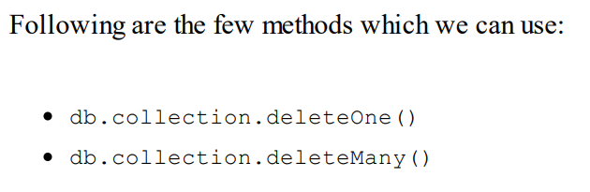
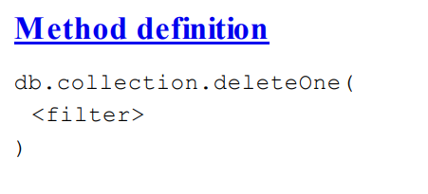
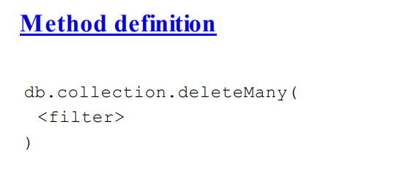
db.books.deleteMany({}) // delete all documents

Slide 22
Nested documents
[
{
"title": "The Man of Glory",
"author": "Raj",
"pages": 456,
"genres": ["historical", "drama"],
"rating": 6,
"reviews": [
{
"name": "Alice",
"review": "A captivating story with deep character development, but a bit lengthy."
},
{
"name": "John",
"review": "Good historical context, but the pace was slow at times."
}
]
},

Slide 23
{
"title": "A Laugh and a Tear",
"author": "Arun",
"pages": 355,
"genres": ["comedy", "drama"],
"rating": 8,
"reviews": [
{
"name": "Emily",
"review": "Hilarious and heartfelt at the same time! A great balance of comedy and emotion."
},
{
"name": "Michael",
"review": "Some parts were touching, but the humor didn't always land for me."
}
]
},

Slide 24
{
"title": "The Great Adventure",
"author": "Sara",
"pages": 275,
"genres": ["adventure", "fiction"],
"rating": 9,
"reviews": [
{
"name": "James",
"review": "A thrilling and adventurous ride from start to finish. Couldn't put it down!"
},
{
"name": "Sophia",
"review": "Amazing world-building and plot twists, but I wished for more character depth."
}
]
},

Slide 25
{
"title": "Mystery of the Lost Island",
"author": "David",
"pages": 312,
"genres": ["mystery", "thriller"],
"rating": 7,
"reviews": [
{
"name": "Lucas",
"review": "Great mystery, but the ending felt a bit rushed."
},
{
"name": "Olivia",
"review": "I was hooked throughout, though the clues were a bit predictable."
}
]
}
]

Slide 26
Database Methods
db.createCollection(): Creates a new collection.
db.getCollectionNames(): Lists all collections in the current database.
db.dropDatabase(): Deletes the current database.
db.stats(): Displays statistics about the current database.

Slide 27
Collection Methods
db.collection.insertOne(): Inserts a single document into the collection.
db.collection.insertMany(): Inserts multiple documents into the collection.
db.collection.find(): Queries documents in the collection.
db.collection.findOne(): Returns one document that matches the query.
db.collection.updateOne(): Updates a single document that matches the query.
db.collection.updateMany(): Updates multiple documents that match the query.
db.collection.replaceOne(): Replaces a single document.
db.collection.deleteOne(): Deletes a single document that matches the query.
db.collection.deleteMany(): Deletes multiple documents that match the query.
db.collection.drop(): Deletes the collection.
db.collection.countDocuments(): Returns the count of documents in a collection.
.

Slide 28
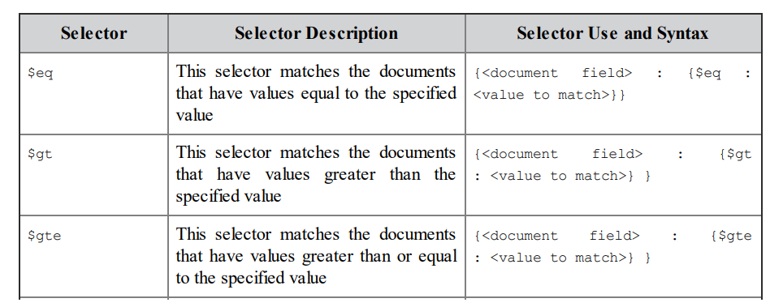
MongoDB Operators: Comparison Operators

Slide 29
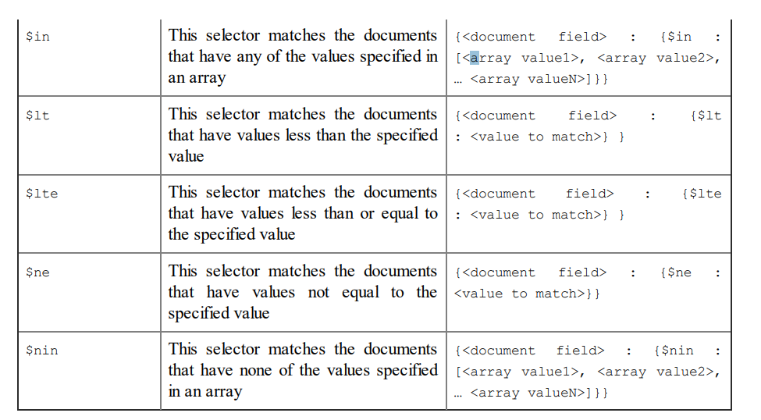

Slide 30
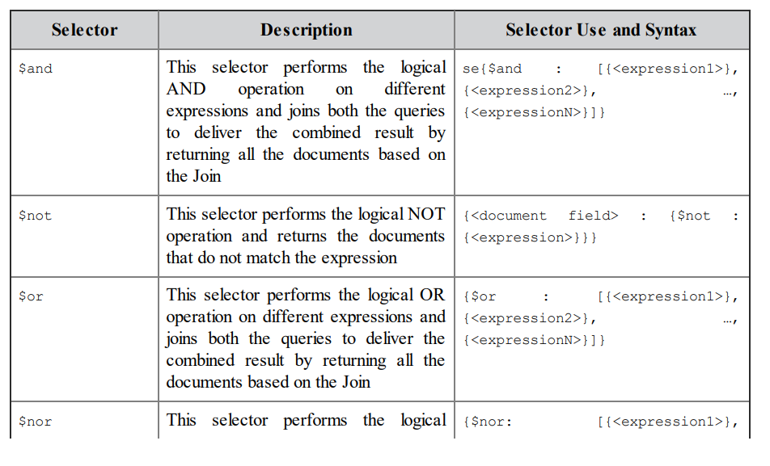

Logical
Operators

Slide 31
Operators
Bookstore> db.Books.find({rating: {$gt:9}}) # rating greater than 9
Bookstore> db.Books.find({rating: {$lt:8}})
Bookstore> db.Books.find({rating: {$lte:8}}) # less than or equal to 8
Bookstore> db.Books.find({rating: {$lt:8}, pages: {$gt:50}}) #more check conditions
Bookstore> db.Books.find({$or: [{rating:9},{rating:9.5}]}) # or operator
Bookstore> db.Books.find({$and: [{rating:9},{genres: "tragedy"}]})
Bookstore> db.Books.find({$or: [{pages:{$lt: 400}},{pages:{$gt: 320}}]})

Slide 32
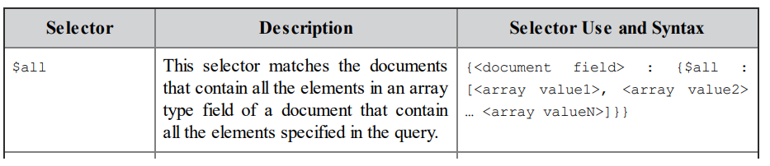
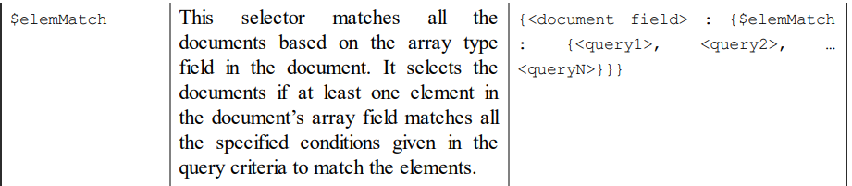
Array Operators
Bookstore> db.Books.find({genres: {$all: ["tragedy","comedy"]}}) -- Books containing genres both tragedy and comedy

Slide 33
Filters to query based on arrays
Bookstore> db.Books.find({genres: "tragedy"}) -- Books containing genre is tragedy
Bookstore> db.Books.find({genres: ["tragedy"]}) -- Books containing only genre is tragedy
Bookstore> db.Books.find({genres: {$all: ["tragedy","comedy"]}}) -- Books containing genres both tragedy and comedy
Bookstore> db.myCollection.find({"reviews.name":"James"}) – The details of the books with review written by James

Slide 34
Annexure: Update Operators
$set: Sets the value of a field in a document.
$unset: Removes the specified field from a document.
$inc: Increments the value of a field by a specified amount.
$rename: Renames a field.
$push: Adds an item to an array.
$pop: Removes the first or last item of an array.
$pull: Removes items from an array that match a specified condition.
$addToSet: Adds an item to an array only if it doesn't already exist.
$mul: Multiplies the value of a field by a specified amount.
$min: Updates the field to a specified value if the specified value is less than the current value.
$max: Updates the field to a specified value if the specified value is greater than the current value.

